Slide 1
Debugging NEO Accounts and Addresses
Michael Herman
mwherman2000/neo-windocs Project
neotoronto@outlook.com

Slide 2
Verification Contract
3.1 Contract Verification
Unlike the public-key account system used in Bitcoin, NEO's account system uses the contract account system. Each account in the NEO corresponds to a verification contract, and the hash value of the verification contract, is the account address; The program logic of the verification contract controls the ownership of the account. When transferring from an account, you firstly need to execute the verification contract for that account. A validation contract can accept a set of parameters (usually a digital signature or other criteria), and return a boolean value after verification, indicating the success of the verification to the system.
The user can deploy the verification contract to the blockchain beforehand, or publish the contract content directly in the transaction during the transfer process.
Reference: https://github.com/neo-project/docs/blob/bd7b05d55f3fb41c1a094bbd80dec6f08163c978/en-us/sc/white-paper.md#3-contract-use

Slide 3
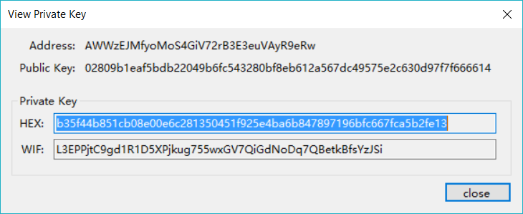
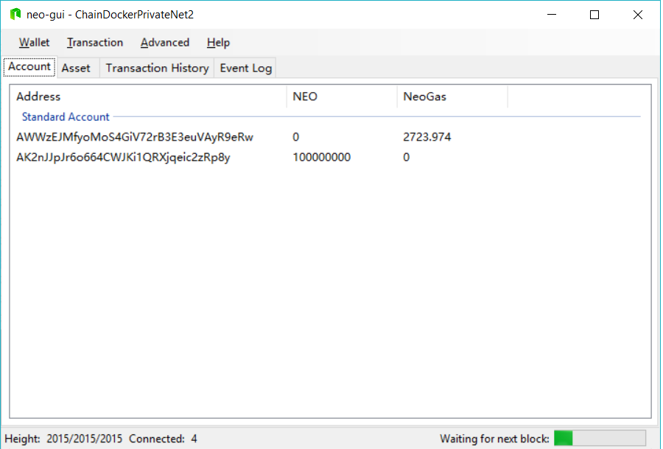
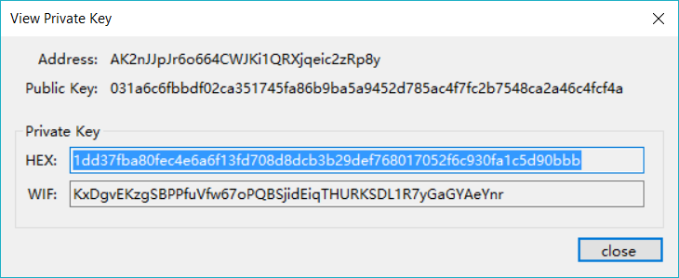

Slide 4
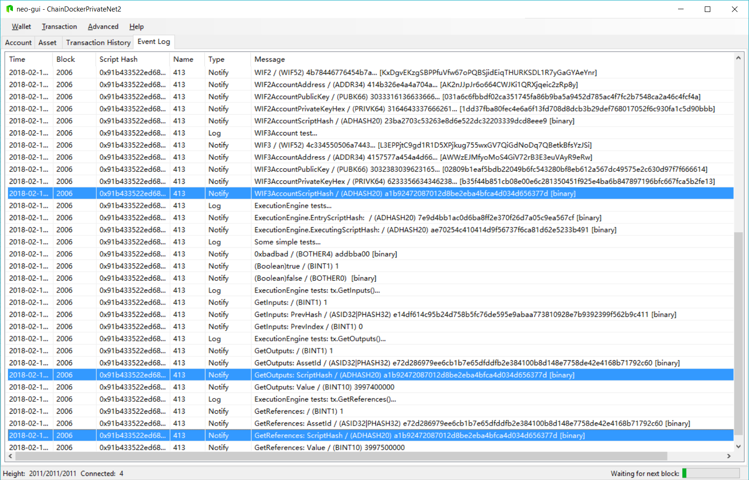

Slide 5
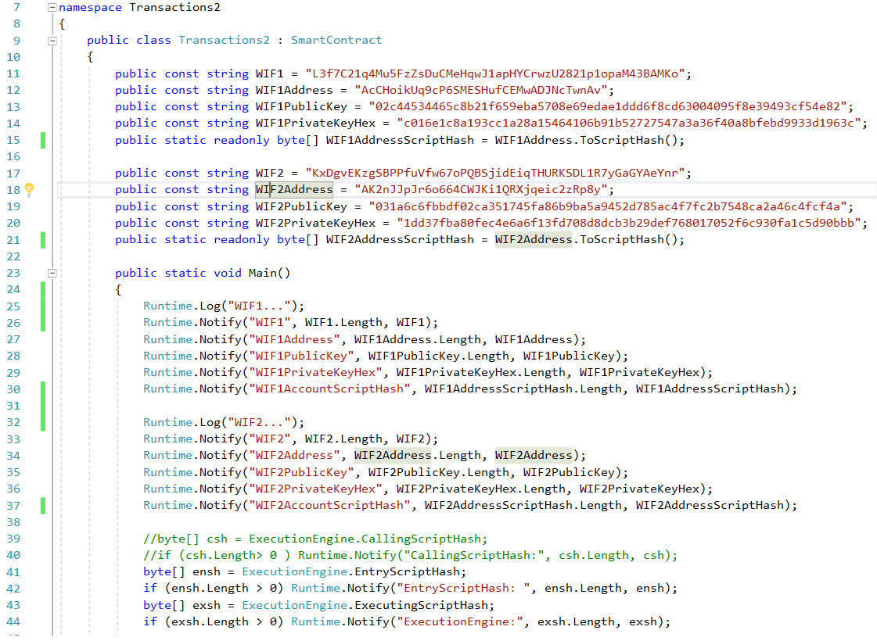

Slide 6
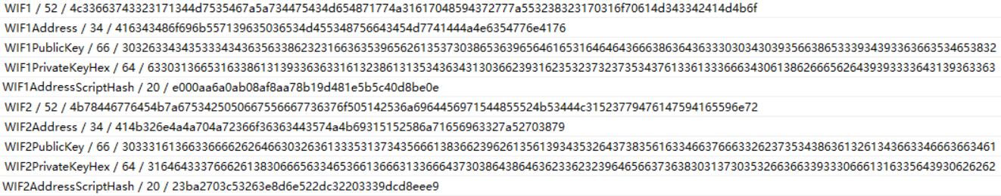
23ba2703c53263e8d6e522dc32203339dcd8eee9

Slide 7
Wallet Import Format (WIF)
Also known as Wallet Export Format
Detailed reference: https://en.bitcoin.it/wiki/Wallet_import_format
Private keys are encoded and stored in WIF format

Slide 8
Private key to WIF Reference: https://en.bitcoin.it/wiki/Wallet_import_format
1 - Take a private key 0C28FCA386C7A227600B2FE50B7CAE_SAMPLE_PRIVATE_KEY_DO_NOT_IMPORT_11EC86D3BF1FBE471BE89827E19D72AA1D
2 - Add a 0x80 byte in front of it for mainnet addresses or 0xef for testnet addresses. Also add a 0x01 byte at the end if the private key will correspond to a compressed public key 800C28FCA386C7A227600B2FE50B7C_SAMPLE_PRIVATE_KEY_DO_NOT_IMPORT_AE11EC86D3BF1FBE471BE89827E19D72AA1D
3 - Perform SHA-256 hash on the extended key 8147786C4D15106333BF278D71DADAF1079EF2D2440A4DDE37D747DED5403592
4 - Perform SHA-256 hash on result of SHA-256 hash 507A5B8DFED0FC6FE8801743720CEDEC06AA5C6FCA72B07C49964492FB98A714
5 - Take the first 4 bytes of the second SHA-256 hash, this is the checksum 507A5B8D
6 - Add the 4 checksum bytes from point 5 at the end of the extended key from point 2 800C28FCA386C7A227600B2FE50B7CAE11EC8_SAMPLE_PRIVATE_KEY_DO_NOT_IMPORT_6D3BF1FBE471BE89827E19D72AA1D507A5B8D
7 - Convert the result from a byte string into a base58 string using Base58Check encoding. This is the Wallet Import Format 5HueCGU8rMjxEXxiPuD5BDk_SAMPLE_PRIVATE_KEY_DO_NOT_IMPORT_u4MkFqeZyd4dZ1jvhTVqvbTLvyTJ

Slide 9
WIF to private key Reference: https://en.bitcoin.it/wiki/Wallet_import_format
1 - Take a Wallet Import Format string 5HueCGU8rMjxEXxiPuD5BDk_SAMPLE_PRIVATE_KEY_DO_NOT_IMPORT_u4MkFqeZyd4dZ1jvhTVqvbTLvyTJ
2 - Convert it to a byte string using Base58Check encoding 800C28FCA386C7A227600B2FE50B7CAE11EC_SAMPLE_PRIVATE_KEY_DO_NOT_IMPORT_86D3BF1FBE471BE89827E19D72AA1D507A5B8D
3 - Drop the last 4 checksum bytes from the byte string 800C28FCA386C7A227600B2FE50B7CAE11EC86D3BF1FBE471BE89827E19D72AA1D
4 - Drop the first byte (it should be 0x80). If the private key corresponded to a compressed public key, also drop the last byte (it should be 0x01). If it corresponded to a compressed public key, the WIF string will have started with K or L instead of 5 (or c instead of 9 on testnet). This is the private key. 0C28FCA386C7A227600B2FE50B7CAE1_SAMPLE_PRIVATE_KEY_DO_NOT_IMPORT_1EC86D3BF1FBE471BE89827E19D72AA1D

Slide 10
WIF checksum checking Reference: https://en.bitcoin.it/wiki/Wallet_import_format
1 - Take the Wallet Import Format string 5HueCGU8rMjxEXxiPuD5BD_SAMPLE_PRIVATE_KEY_DO_NOT_IMPORT_ku4MkFqeZyd4dZ1jvhTVqvbTLvyTJ
2 - Convert it to a byte string using Base58Check encoding 800C28FCA386C7A227600B2FE50B7CAE11E_SAMPLE_PRIVATE_KEY_DO_NOT_IMPORT_C86D3BF1FBE471BE89827E19D72AA1D507A5B8D
3 - Drop the last 4 checksum bytes from the byte string 800C28FCA386C7A227600B2FE50B7CAE11EC86D3BF1FBE471BE89827E19D72AA1D
3 - Perform SHA-256 hash on the shortened string 8147786C4D15106333BF278D71DADAF1079EF2D2440A4DDE37D747DED5403592
4 - Perform SHA-256 hash on result of SHA-256 hash 507A5B8DFED0FC6FE8801743720CEDEC06AA5C6FCA72B07C49964492FB98A714
5 - Take the first 4 bytes of the second SHA-256 hash, this is the checksum 507A5B8D
6 - Make sure it is the same, as the last 4 bytes from point 2 507A5B8D
7 - If they are, and the byte string from point 2 starts with 0x80 (0xef for testnet addresses), then there is no error.

Slide 11
NEO Account Addresses, Keys and Key Lengths
Description Length (byte[]/HexString) Examples (Bold Lengths)
WIF1 (52/104) L3f7C21q4Mu5FzZsDuCMeHqwJ1apHYCrwzU2821p1opaM43BAMKo
WIF1Address (34/68) AcCHoikUq9cP6SMESHufCEMwADJNcTwnAv
WIF1PublicKeyHex (33/66) 02c44534465c8b21f659eba5708e69edae1ddd6f8cd63004095f8e39493cf54e82
WIF1PrivateKeyHex (32/64) c016e1c8a193cc1a28a15464106b91b52727547a3a36f40a8bfebd9933d1963c
WIF1AddressScriptHash (20/40) e000aa6a0ab08af8aa78b19d481e5b5c40d8be0e
= WIF1Address.AsScriptHash();
WIF2 (52/104) KxDgvEKzgSBPPfuVfw67oPQBSjidEiqTHURKSDL1R7yGaGYAeYnr
WIF2Address (34/68) AK2nJJpJr6o664CWJKi1QRXjqeic2zRp8y
WIF2PublicKeyHex (33/66) 031a6c6fbbdf02ca351745fa86b9ba5a9452d785ac4f7fc2b7548ca2a46c4fcf4a
WIF2PrivateKeyHex (32/64) 1dd37fba80fec4e6a6f13fd708d8dcb3b29def768017052f6c930fa1c5d90bbb
WIF2AddressScriptHash (20/40) 23ba2703c53263e8d6e522dc32203339dcd8eee9
= WIF2Address.AsScriptHash();
TxID, AssetID (32/64) 687b68a1159429dc558e4fc7590e391d52f1ef79a12922f941daa37c00334ec5

Slide 12
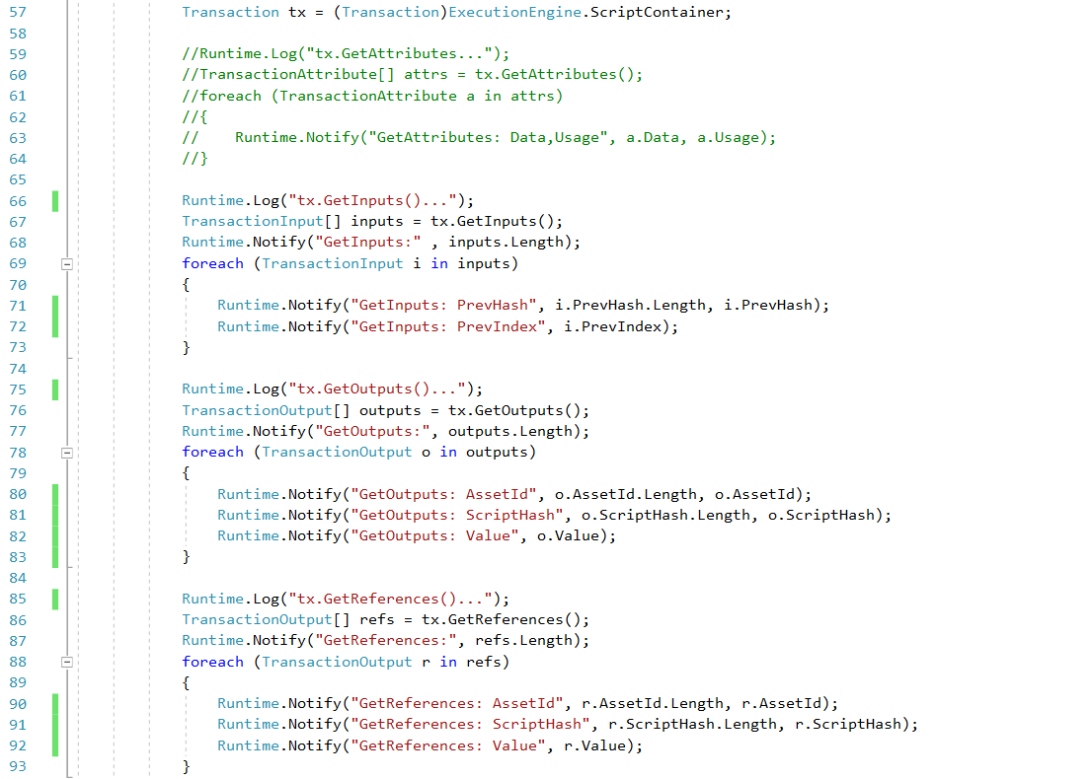

Slide 13
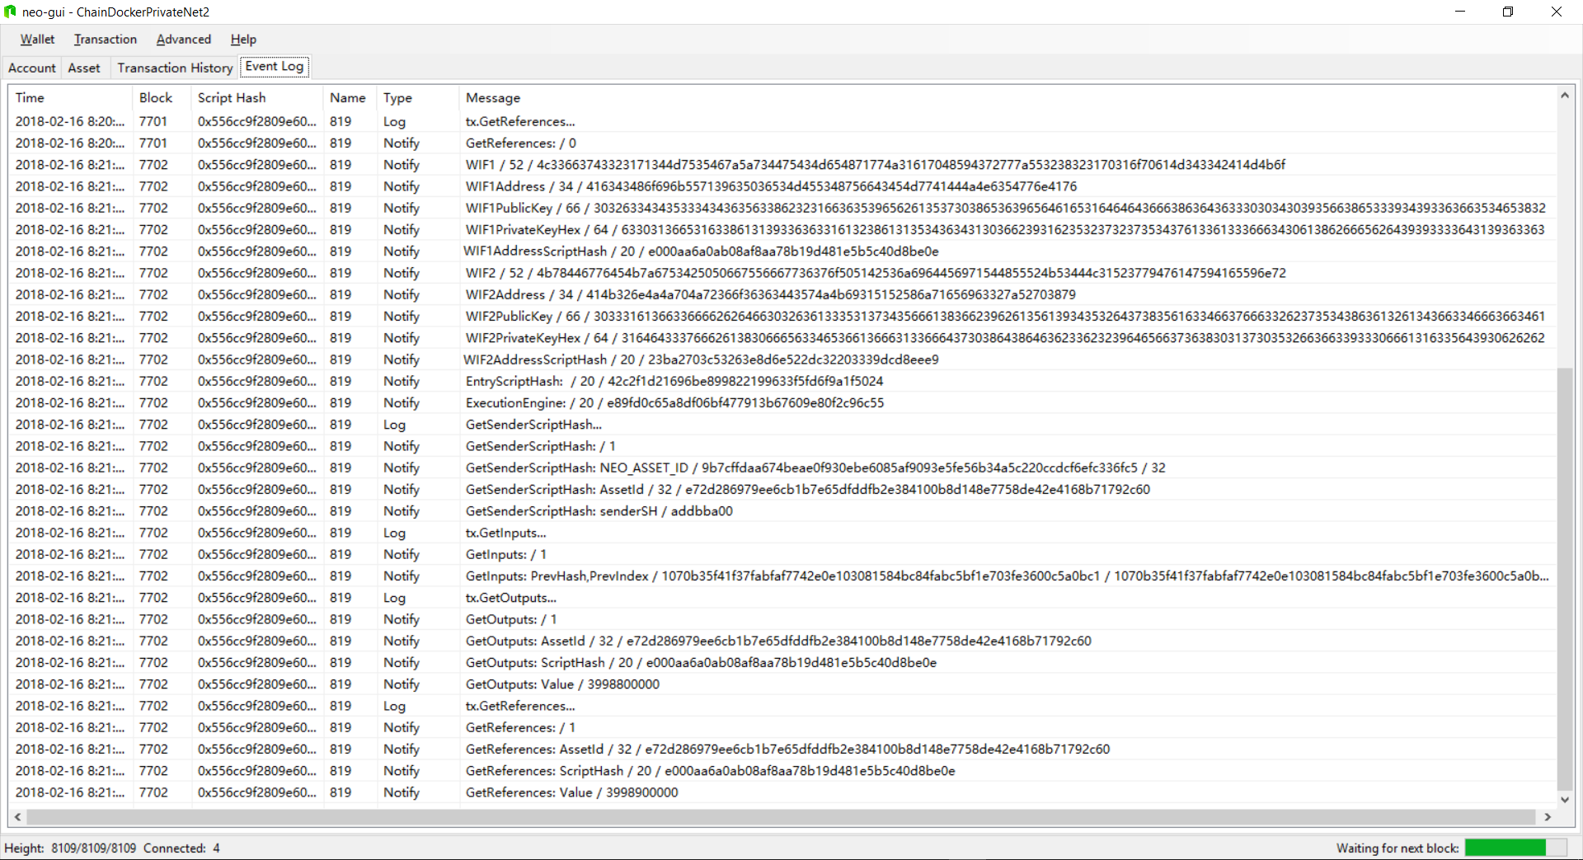

Slide 14
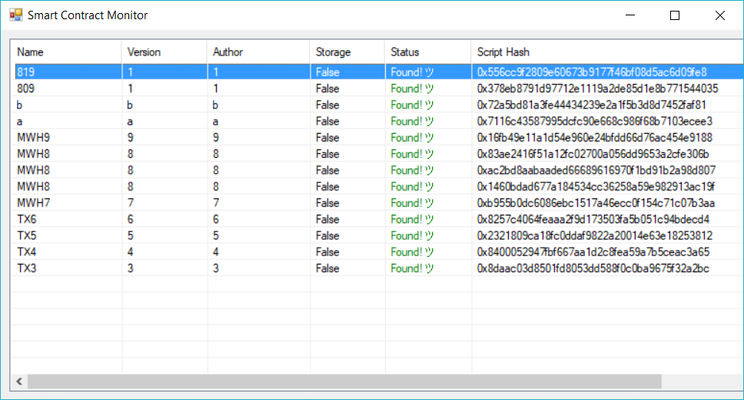

Slide 17
Runtime.CheckWitness(addressScriptHash)
private static bool Register(string domainName, byte[] ownerScriptHash)
{
if (!Runtime.CheckWitness(ownerScriptHash)) return false;
byte[] entry = Storage.Get(Storage.CurrentContext, domainName);
if (entry != null) return false;
Storage.Put(Storage.CurrentContext, domainName, ownerScriptHash);
return true;
}
The semantics of the CheckWitness() call in the above Register() function are:
If the invoking caller doesn’t match the ownerScriptHash passed into the function, don’t let the caller register a domain in the name of this owner.
That is, only permit domains to be registered to ownerScriptHash if ownerScriptHash is the actual caller.
Sample parameter value: public static readonly byte[] ownerScriptHash = "ATrzHaicmhRj15C3Vv6e6gLfLqhSD2PtTr".ToScriptHash();

Slide 18
VerifySignature(signature, addressScriptHash)
VerifySignature(signature, addressScriptHash) is a common method in several crypto libraries.
Here’s a one example (with a code sample):
https://msdn.microsoft.com/en-us/library/0h05c7e2(v=vs.110).aspx
The general semantics are:
Verify a (digital) signature still matches the specific hash for some specific data (array of bytes)
That is, has the underlying data (and hence, the computed hash) been altered since the signature of the original hash was calculated.
…the essence of what a digital signature is
On the NEO platform, if the addressScriptHash is hardcoded in the smart contract (similar to the line of code at the bottom of the previous slide), VerifySignature() can used to verify that the signature passed in by the caller is valid …that is, that they have the signature needed to validate the hardcoded addressScriptHash (and have the correct/matching signature for it) TODO

